Slide 1

Office Hours Queue System - [ ] X
Welcome To The Georgia Tech Computer Science Office Hours Queueing System
Please Enter Your Monitors Dimensions: .
Please Enter Your Class Name .
Please Select Your Class Roster .csv .
This is the xlsx.xlsx file you downloaded from Canvas and exported as a csv
405 Students Detected 17 Tas Detected
1920
1080
ex. CS 2110
xlsx.csv
Confirm

Slide 2
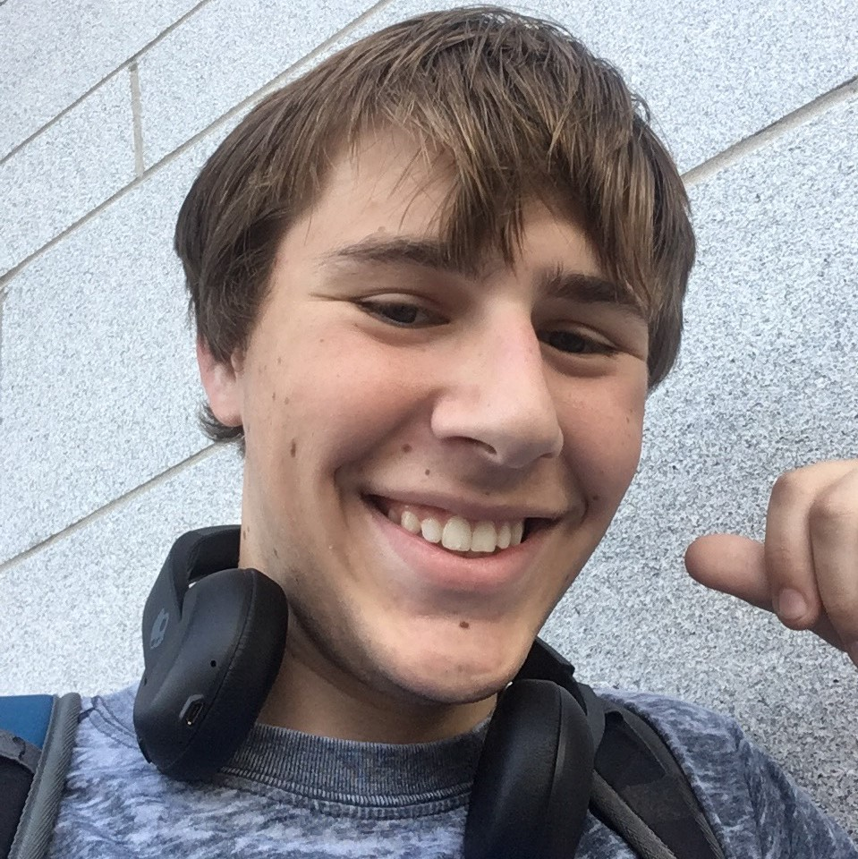
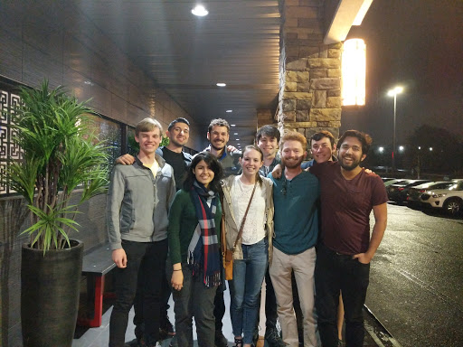
Office Hours Queue System - [ ] X
CS 2110 Office Hours Queue
TA’s On Duty:
Benjamin Yarmowich
Jarret Schultz
Manley Roberts
To Join The Queue Swipe Your Buzzcard or Type In Your Name Below
Your Name
Student Queue:
Hillary Duff
Shaggy Buster
Gump Feldspar
Swister Johns
Torrid Punkins

Slide 3

Office Hours Queue System - [ ] X
CS 2110 Office Hours Queue
TA’s On Duty:
Benjamin Yarmowich
Jarret Schultz
Manley Roberts
To Join The Queue Swipe Your Buzzcard or Type In Your Name Bellow
Your Name
Student Queue:
^
Hillary Duff
^
^
Shaggy Buster
^
^
Gump Feldspar
^
^
Swister Johns
^
Torrid Punkins

Slide 4
Office Hours Queue System - [ ] X
CS 2110 Office Hours Queue
TA’s On Duty:
Benjamin Yarmowich
Jarret Schultz
Manley Roberts
To Join The Queue Swipe Your Buzzcard or Type In Your Name Bellow
Your Name
Student Queue:
Hillary Duff
Shaggy Buster
Gump Feldspar
^
Swister Johns
Torrid Punkins

